Slide 1
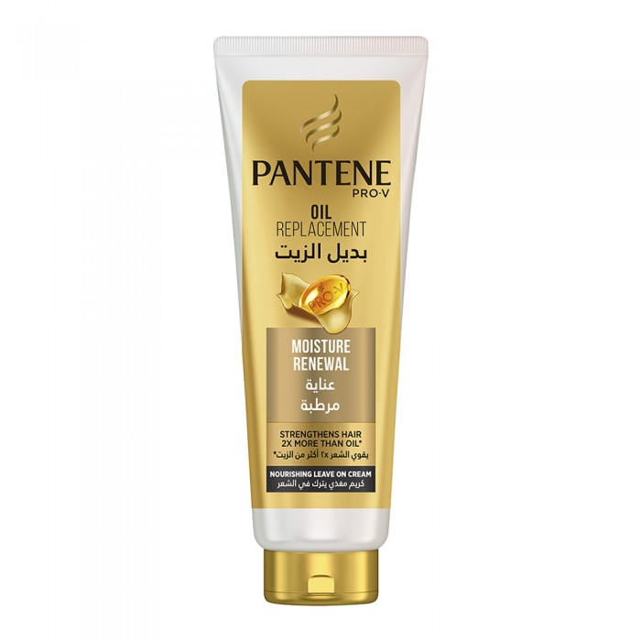
Pantene
Pantene Oil Alternative Pro-in Hair Moisturizing Care 350ml
SAR 25.30 Q
Helps protect the most vulnerable hair and makes even the driest hair softer, easier to comb and more manageable
- Oil Alternative Pantene Pro-in Skin Rejuvenation
- Intensively regenerates damaged hair and helps cope with the effects of daily styling
- Penetrates into hair to give it better nourishment, smoothness and shine (compared to traditional oil)
- Provides protection against future styling and drying damage
- for dry hair

Slide 2
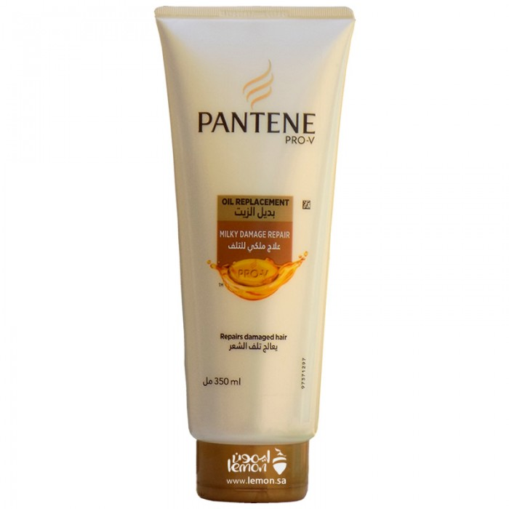
Pantene
Oil substitute pantene to treat dry and canteen hair problems
22.77 SA

Slide 3
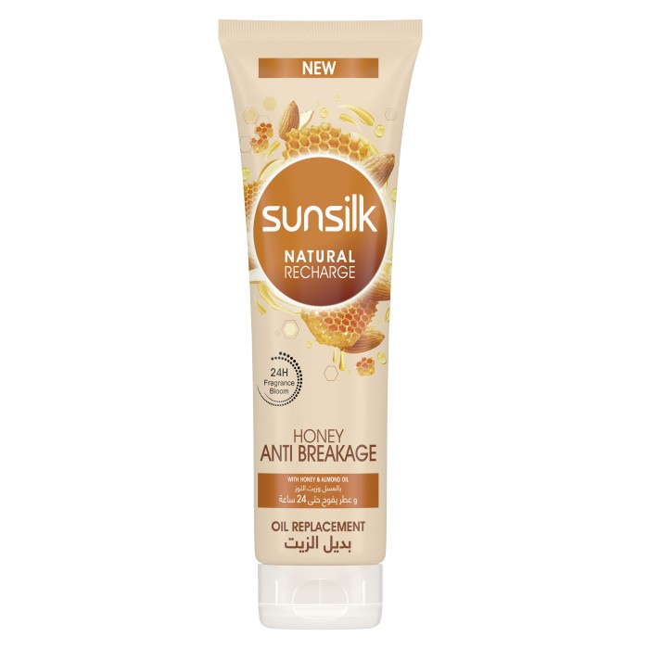
Sunsilk Oil Alternative with Honey and Almond Oil 300 ml
26.45 SAR. Q
Enjoy the most beautiful feeling with our new collection against hair shelling containing honey and almond oil. Our exclusive oil replacement formula immediately penetrates into. Your hair gives it softness and strength 5 times more to a 24-hour fragrance. The mild and non-fatty formula keeps your hair fresh and vital

